Slide 1
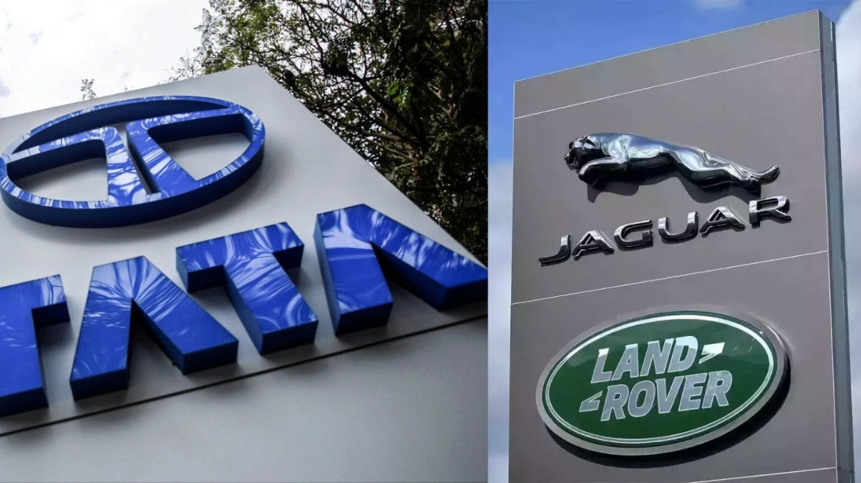
Supply Forecasting and Planning
Jaguar and Land Rover
Leveraging historical data to optimize inventory management, production schedules and strategic resource allocation across models and distribution channels.

Slide 2




Project Objectives
Analyze Historical Data
Optimize Inventory
Examine sales and distribution data including annually, quarterly sales (Q1–Q4) by car & models
Identify high-demand and low-demand models, monitor wholesale vs retail gaps.
Support Production Planning
Improve Sales Strategy
Use trend analysis, seasonal patterns and model-level demand forecasts.
Highlight top-performing models, market share contributions and sales stability.

Slide 3

Company History
Tata Motors, founded in 1945 as TELCO, expanded from locomotives to passenger cars.
In 2008, Tata Motors acquired Jaguar and Land Rover from Ford for $2.3 billion.
Post-acquisition, JLR became profitable with models like Range Rover Evoque and Jaguar F-Type, strengthening Tata’s global luxury market presence.
Despite JLR facing losses at acquisition, Tata Motors invested in research, technology, and new models. Within years, JLR turned profitable with popular models like Range Rover Evoque and Jaguar F-Type.

Slide 4
Wholesale Sales: Rise and Fall
1
Early Years
Sales started at 4.3 lakh, showing steady growth
2
Peak Performance
Around year 10, sales reached 10 lakh—the highest point
3
Decline Phase
Sales fell consistently after year 15
4
Current State
Dropped to 2.3 lakh by year 17—the lowest level

Slide 5
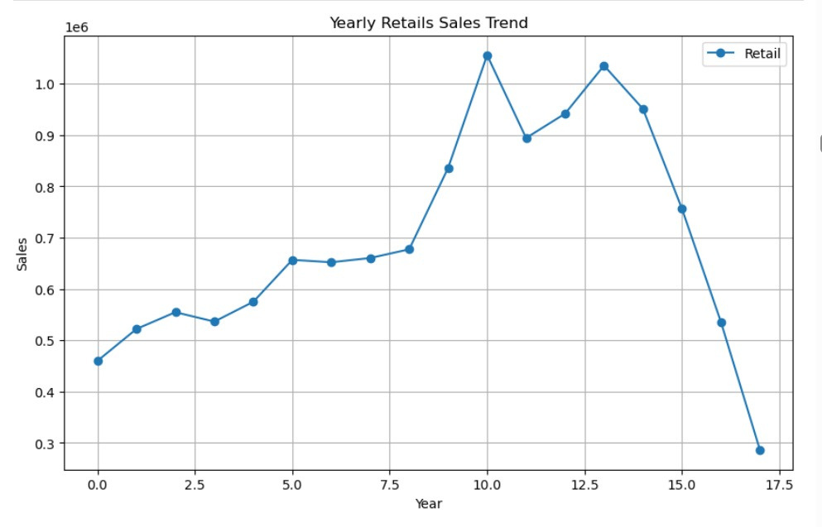
Retail Sales Trajectory
Retail sales followed a similar pattern: steady growth, peak performance around year 10, fluctuations until year 14, then a sharp decline from year 15 onward.
Key Insight: Both wholesale and retail experienced long growth periods followed by sudden decline in recent years, signaling market challenges.

Slide 6

Model Performance Comparison
Top Performers
Excess Inventory
Market Demand
Discovery, Range Rover, Range Rover Sport and Range Rover Evoque show retail sales exceeding wholesale.
Defender and New Range Rover Sport show higher wholesale than retail, indicating unsold dealer stock.
Popular models demonstrate strong wholesale and retail balance, while lower-demand models show smaller volumes.

Slide 7
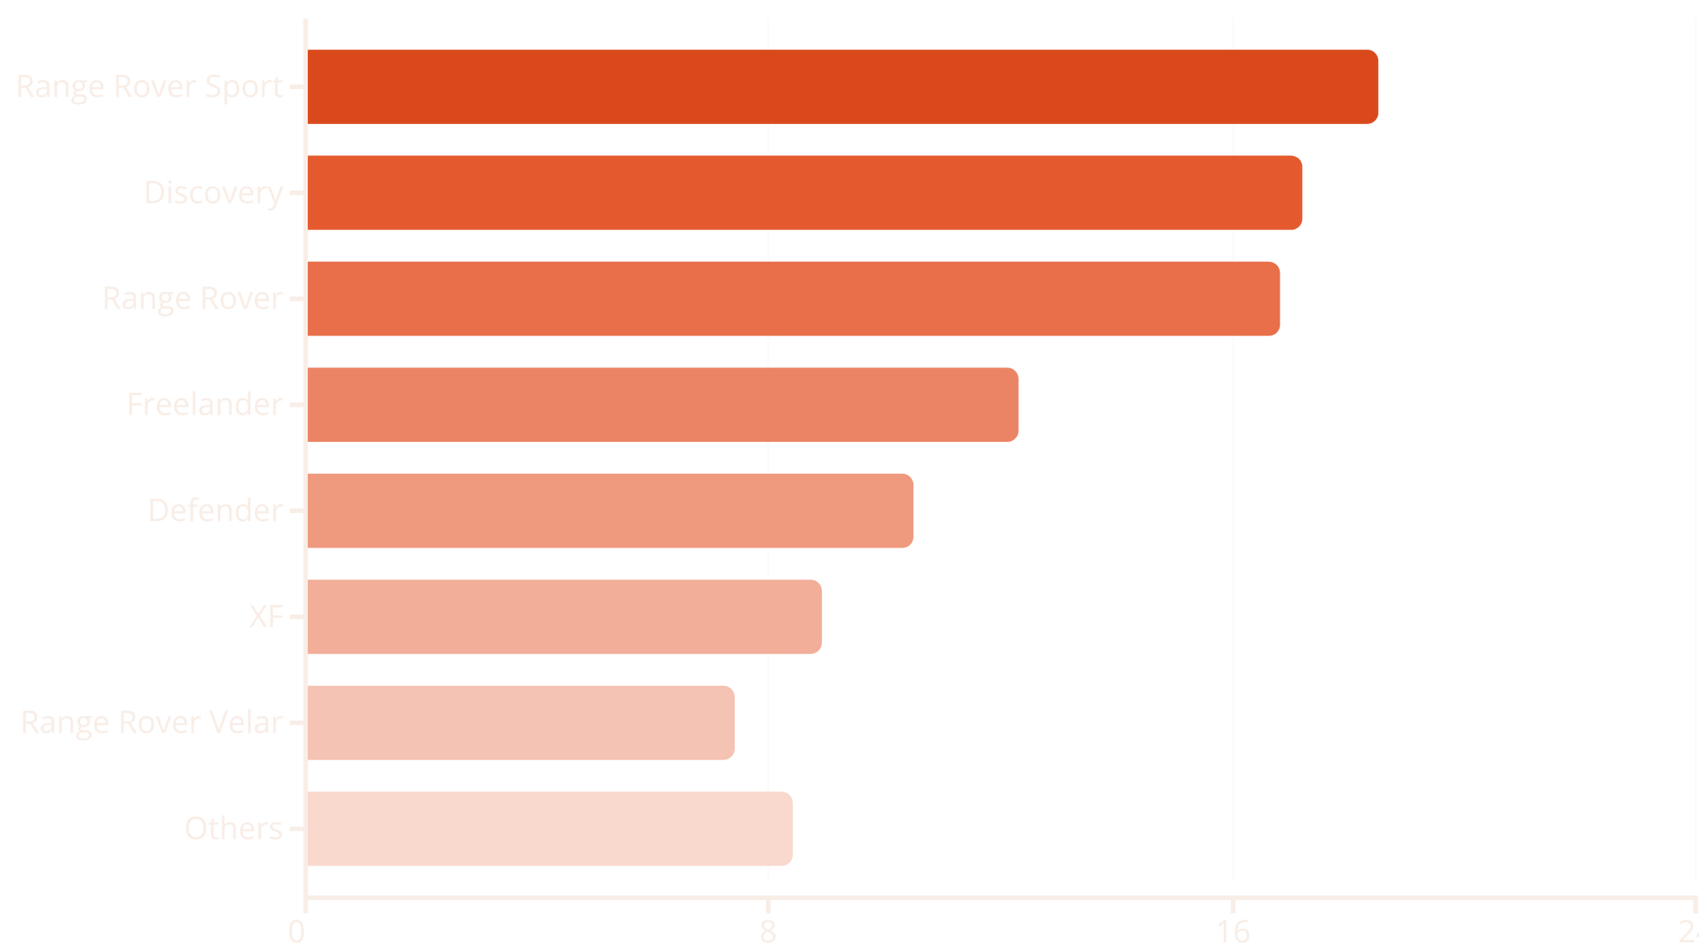
Market Share Leaders
Range Rover and Discovery models dominate the market, while F-TYPE, Jaguar XE, and other models hold minimal market share.

Slide 8
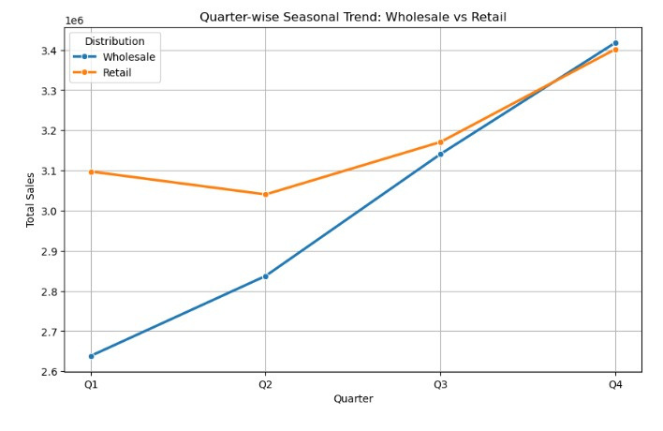
Seasonal Sales Patterns
Quarterly Trends
Retail: Starts high in Q1 (3.1M), dips in Q2, rises through Q3 and Q4 to 3.45M
Wholesale: Begins lower in Q1 (2.64M), shows consistent growth each quarter, surpassing retail by Q4 at 3.46M
Q4 shows peak performance for both channels, driven by seasonal demand.

Slide 9
Supply Gap Analysis
Top Oversupplied Models
Discovery Sport +5,072 units excess stock
Models F -pace, E - Pace, F-Pace: Positive differences indicating overstocking
Top Undersupplied Models
Range Rover Sport : -19,043 units shortage
Models Discovery, Range Rover,Defender: Negative differences showing demand exceeds supply
Analysis reveals critical need to balance production and inventory across model lines to match market demand.

Slide 10
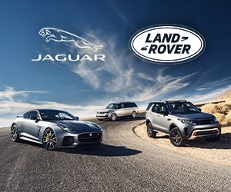
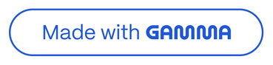
Forecasting Overview
Our annual forecasting, it offers a well-rounded view of trends and performance across different vehicle categories when combined with Quarterly forecasting helps us stay agile by capturing seasonal changes and emerging patterns, allowing quick adjustments to our strategy as market conditions evolve. This approach supports informed planning for the year ahead by analyzing both car types helping us identify growth opportunities and understand market dynamics more effectively.

Slide 11
Annual Sales
Our three-year forecast reveals steady growth trajectories for both Jaguar and Land Rover brands, with Land Rover maintaining a stronger market position throughout the period.
2026 Projections
2027 Projections
2028 Projections
Jaguar: 386,647 units
Jaguar: 396,848 units
Jaguar: 407,048 units
Land Rover: 438,911 units
Land Rover: 442,174 units
Land Rover: 445,437 units
Combined total of 825,558 vehicles
Combined total of 839,022 vehicles
Combined total of 852,485 vehicles

Slide 12
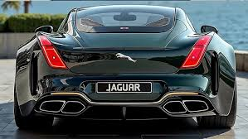
Jaguar: Three-Year Growth Story
Jaguar's forecast shows consistent annual growth of approximately 2.6%, adding over 20,000 units from 2026 to 2028. This steady trajectory reflects brand positioning in the luxury segment and strategic market expansion initiatives.
386K
2026
Key Growth Indicators:
407K
2026-2027: +10,201 units (2.64% growth)
2028
2027-2028: +10,200 units (2.57% growth)
Total three-year increase: 5.27%

Slide 13
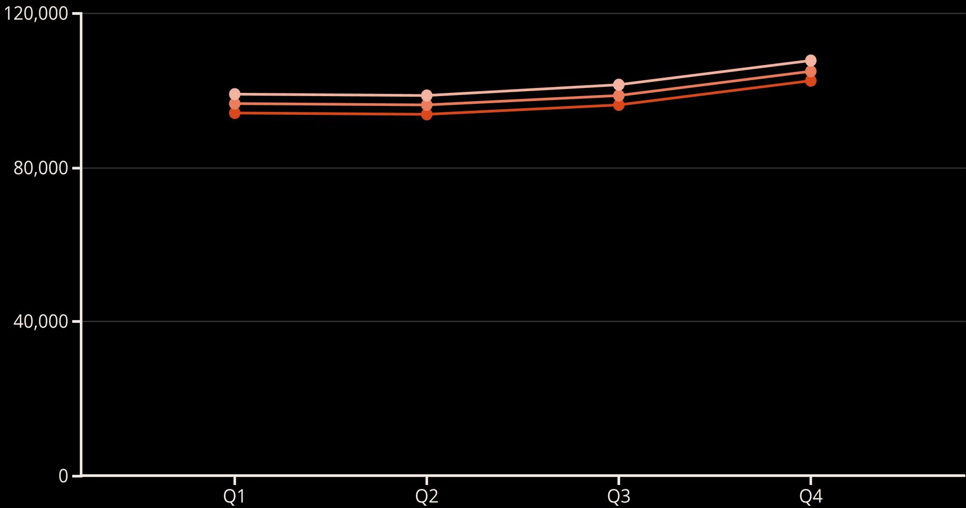
Jaguar Quarterly Analysis
2026 Quarters
Q1: 94149 units
Q2: 93806 units
Q3: 96259 units
Q4: 102433 units
2027 Quarters
2028 Quarters
Q1: 96633 units
Q1: 99116 units
Q2: 96281 units
Q2: 98756 units
Q3: 98799 units
Q3: 101338 units
Q4: 105136 units
Q4: 107838 units

Slide 14
Quarterly Performance Patterns
Quarterly data reveals distinct seasonal patterns across both brands, with Q4 consistently delivering the strongest performance and Q2 showing the softest results.
1
2
Q1 Performance
Q2 Softness
Strong start to the year with solid momentum from previous quarter
Typically the weakest quarter, requiring strategic promotional support
3
4
Q3 Recovery
Q4 Peak
Rebound in sales as new model year launches gain traction
Strongest quarter driven by year-end incentives and holiday demand

Slide 15
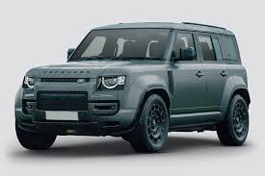
Land Rover: Market Leadership
Land Rover maintains its position as the volume leader with projected sales exceeding 438,000 units annually. The brand's growth is more conservative but stable, reflecting its established market presence.
1
2026
438,911 units
Strong foundation year
2
2027
442,174 units
+0.74% growth
3
2028
445,437 units
+0.74% growth

Slide 16
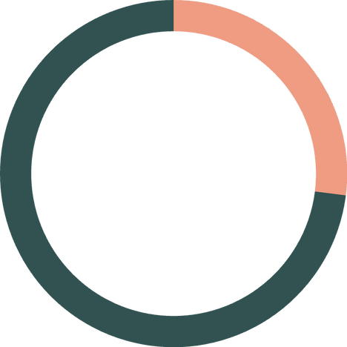
Land Rover Quarterly Analysis
2026 Quarters
2028 Quarters
Q1: 107,014 units
Q1: 108,606 units
Q2: 103,910 units
Q2: 105,455 units
Q3: 109,653 units
Q3: 111,283 units
Q4: 118,334 units
Q4: 120,093 units
2027 Quarters
Q1: 107,810 units
Q2: 104,683 units
Q3: 110,468 units
27%
Q4: 119,214 units
Q4 share of annual volume

Slide 17



Strategic Insights
Consistent Growth
Seasonal Patterns
Market Positioning
Both brands demonstrate reliable year-over-year growth, with Jaguar showing stronger percentage gains while Land Rover maintains volume leadership.
Q4 consistently delivers 26-27% of annual volume, requiring strategic inventory and marketing planning to capitalize on peak demand periods.
Land Rover's 52% share of combined volume reflects its broader product portfolio and stronger SUV market positioning versus Jaguar's luxury sedan focus.

Slide 18

Strategic Recommendations
Focus on Winners
Reduce Excess Stock
Prioritize production of high-demand models: Range Rover Sport, Discovery and Range Rover
Control production to avoid oversupply and align wholesale with retail demand
Improve Forecasting
Strengthen Strategy
Enhance demand-supply alignment using quarterly trends and model-level forecasts
Address declining sales trend through targeted marketing and operational efficiency

